Slide 1
CHAPTER - 4
Digital Transmission
Part-1

Slide 2
Introduction
A computer network is designed to send information from one point to another.
This information needs to be converted to either a digital signal or an analog signal for transmission.
  First, we discuss digital-to-digital conversion techniques.
  Second, we discuss analog-to-digital conversion techniques.
  Finally, we discuss transmission modes.

Slide 3
4.1 Digital-to-digital conversion
We said that data can be either digital or analog.
We also said that signals that represent data can also be digital or analog.
In this section, we see how we can represent digital data by using digital signals.
The conversion involves three techniques:
    (1). Line coding (2). Block coding (3). Scrambling.
Line coding is always needed~ block coding and scrambling may or may not be needed.

Slide 4

Line Coding
Line coding is the process of converting digital data to digital signals.
Line coding converts a sequence of bits to a digital signal.
At the sender, digital data are encoded into a digital signal.
At the receiver, the digital data are recreated by decoding the digital signal.

Slide 5
Characteristics
We discuss some common characteristics of different line coding schemes.
Signal Element Versus Data Element:
In data communications, our goal is to send data elements.
A data element is the smallest entity that can represent a piece of information: this is the bit.
Signal element carries data elements.
Data elements are what we need to send; signal elements are what we can send.
Data elements are being carried; signal elements are the carriers.

Slide 6

Cont.
We define a ratio r which is the number of data elements carried by each signal element.
Figure 4.2 Signal element versus data element

Slide 7
Cont.
Suppose each data element is a person who needs to be carried from one place to another.
We can think of a signal element as a car that can carry people.
  When r = 1, it means each person is driving a car.
  When r > 1, it means more than one person is travelling in a car (a carpool, for example).

Slide 8
Cont.
Data Rate Versus Signal Rate:
The data rate defines the number of data elements (bits) sent in 1s. The unit is bits per second (bps).
  The data rate is sometimes called the bit rate.
The signal rate is the number of signal elements sent in 1s. The unit is the baud.
  The signal rate is sometimes called the pulse rate, the modulation rate, or the baud rate.

Slide 9
Cont.
One goal in data communications is to increase the data rate while decreasing the signal rate.
Increasing the data rate increases the speed of transmission; decreasing the signal rate decreases the bandwidth requirement.
  In our car-people analogy, we need to carry more people in fewer cars to prevent traffic jams. We have a limited bandwidth in our transportation system.

Slide 10
Cont.
We now need to consider the relationship between data rate and signal rate (bit rate and baud rate).
This relationship, of course, depends on the value of r. It also depends on the data pattern.
If we have a data pattern of all 1s or all 0s, the signal rate may be different from a data pattern of alternating 0s and 1s.
To derive a formula for the relationship, we need to define three cases: the worst, best, and average. The worst case is when we need the maximum signal rate; the best case is when we need the minimum.

Slide 11
Cont.
In data communications, we are usually interested in the average case.
We can formulate the relationship between data rate and signal rate as
  S = c x N x 1/r bauds
    N is the data rate (bps).
    c is the case factor, which varies for each case.
    S is the number of signal elements.
    r is the previously defined factor.

Slide 12

Example
A signal is carrying data in which one data element is encoded as one signal element ( r = 1). If the bit rate is 100 kbps, what is the average value of the baud rate if c is between 0 and 1?
Solution
We assume that the average value of c is 1/2 . The baud rate is then

Slide 13

Line Coding Schemes
We can roughly divide line coding schemes into five broad categories, as shown in figure.

Slide 14
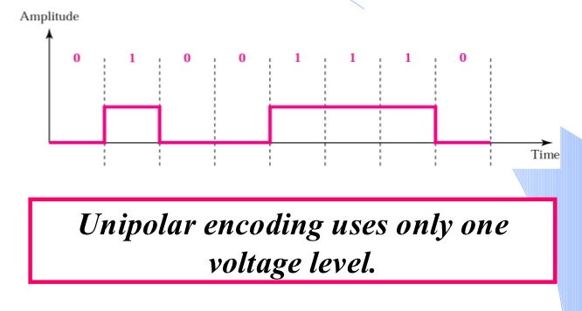
Unipolar Scheme
In a unipolar scheme, all the signal levels are on one side of the time axis, either above or below.
  In this scheme the positive voltage defines bit 1 and the zero voltage defines bit 0.

Slide 15

Cont.
NRZ (Non-Return-to-Zero):
In this scheme the positive voltage defines bit 1 and the zero voltage defines bit 0.
It is called NRZ because the signal does not return to zero at the middle of the bit.

Slide 16
Polar Schemes
In polar schemes, the voltages are on the both sides of the time axis.
For example, the voltage level for 0 can be positive and the voltage level for 1 can be negative.
Polar
NRZ
RZ
Biphase
NRZ-L
NRZ-I
Differential Manchester
Manchester

Slide 17
Cont.
Non-Return-to-Zero (NRZ):
In polar NRZ encoding, we use two levels of voltage amplitude.
We can have two versions of polar NRZ:
  (1). NRZ-L
  (2). NRZ-I.

Slide 18
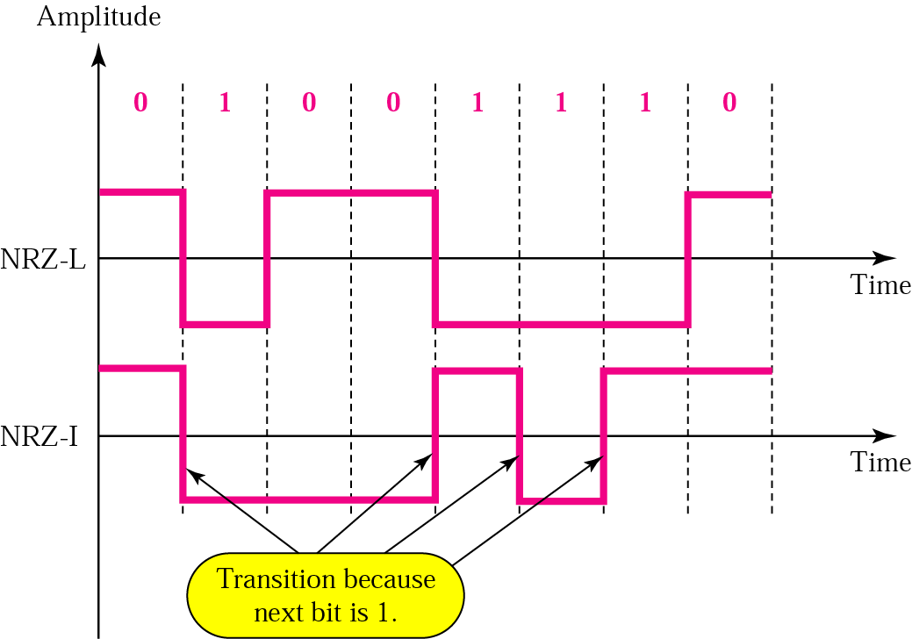
NRZ-L
NRZ-L (NRZ-Level): The level of the voltage determines the value of the bit.

Slide 19
NRZ-I
NRZ-I (NRZ-Invert): The change or lack of change in the level of the voltage determines the value of the bit. If there is no change, the bit is 0; if there is a change, the bit is 1.
0 No Transition
1 Transition

Slide 20
Return to Zero (RZ)
The main problem with NRZ encoding occurs when the sender and receiver clocks are not synchronized.
The receiver does not know when one bit has ended and the next bit is starting.
One solution is the return-to-zero (RZ) scheme, which uses three values:
        (1). Positive (2). Negative (3). Zero.

Slide 21


Cont.
RZ uses three voltage levels,
    Positive voltage to represent 1,
    Negative voltage to represent 0, and
    Zero voltage for none.
In RZ, the signal changes not between bits but during the bit.
In figure we see that the signal goes to 0 in the middle of each bit. It remains there until the beginning of the next bit.

Slide 22
Cont.
The main disadvantage of RZ encoding is that it requires two signal changes to encode a bit and therefore occupies greater bandwidth.
Another problem is the complexity: RZ uses three levels of voltage, which is more complex to create and separate. As a result of all these deficiencies, the scheme is not used today.
Instead, it has been replaced by the better-performing Manchester and Differential Manchester schemes.

Slide 23
Biphase
Signal changes at the middle of the bit interval, does not return to zero, goes to opposite pole.
Good solution to synchronization problem
Two types of biphase encoding used in networks:
    (1). Manchester
    (2). Differential Manchester

Slide 24
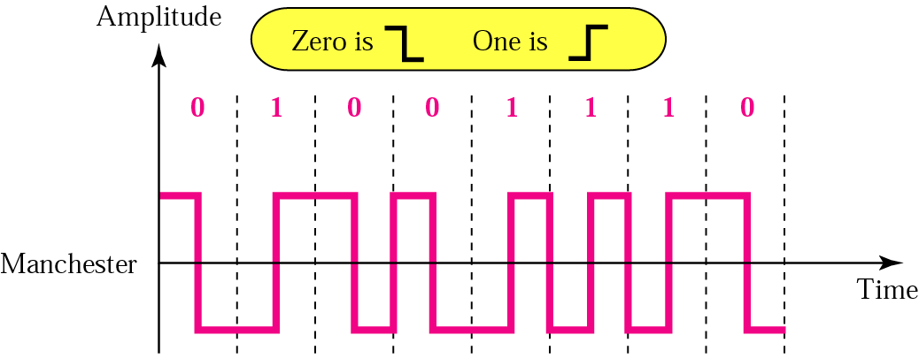
Manchester (IEEE)
Combines the ideas of RZ and NRZ-L. The duration of the bit is divided into two parts. The voltage remains at one level during the first half and moves to the other level in the second half. The transition at the middle of the bit provides synchronization.
This transition is used only to provide clocking.
  +ve to -ve transition for a "0" bit
  -ve to +ve transition for a "1" bit

Slide 25
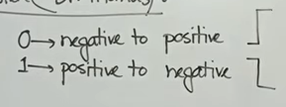
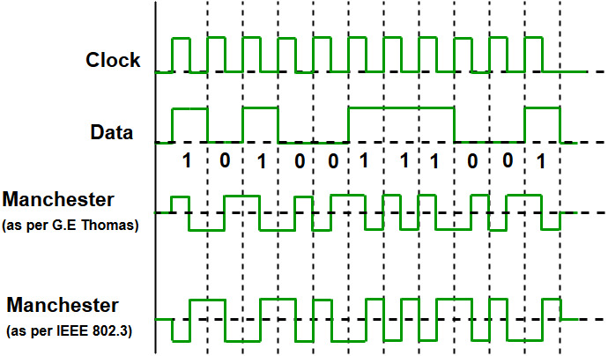
Manchester (Dr. Thomas)
This transition is used only to provide clocking.
  -ve to +ve transition for a "0" bit
  +ve to -ve transition for a "1" bit

Slide 26
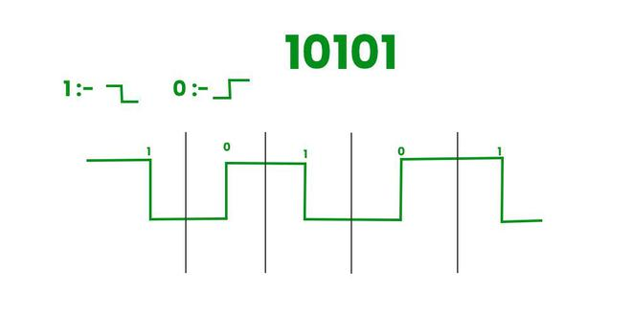
Manchester (Dr. Thomas)
This transition is used only to provide clocking.
  -ve to +ve transition for a "0" bit
  +ve to -ve transition for a "1" bit

Slide 27
Manchester
This transition is used only to provide clocking (IEEE).
  +ve to -ve transition for a "0" bit
  -ve to +ve transition for a "1" bit
This transition is used only to provide clocking (Dr. Thomas).
  -ve to +ve transition for a "0" bit
  +ve to -ve transition for a "1" bit

Slide 28
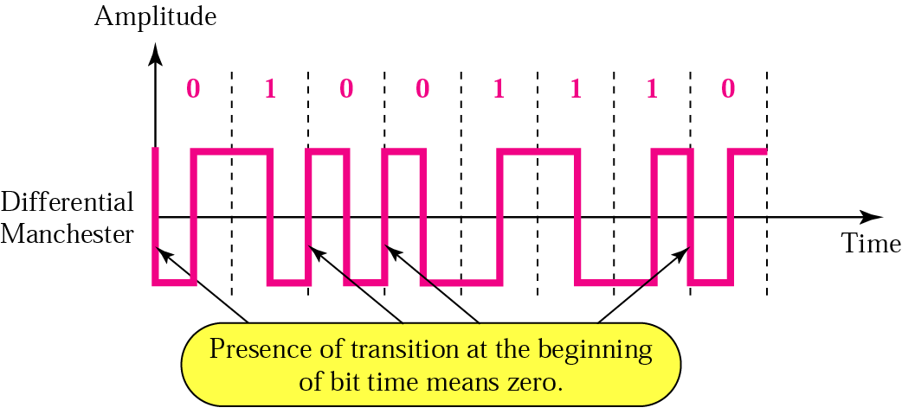
Differential Manchester
Combines the ideas of RZ and NRZ-I.
There is always a transition at the middle of the bit, but the bit values are determined at the beginning of the bit.
Transition at the beginning of the bit cell if the next bit is " 0 "
NO Transition at the beginning of the bit cell if the next bit is " 1 "

Slide 29
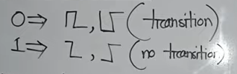
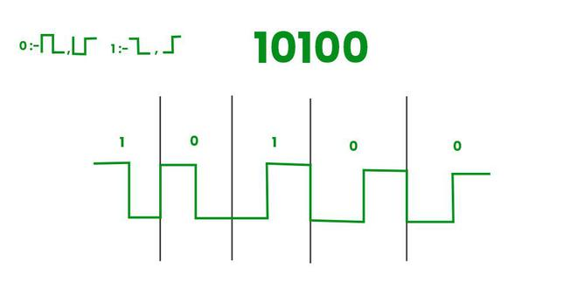
Differential Manchester

